Slide 1
4 Zones Model: Maximizing the Business Value of IT
DevOps Enterprise Summit
London
June 24, 2020

Slide 2
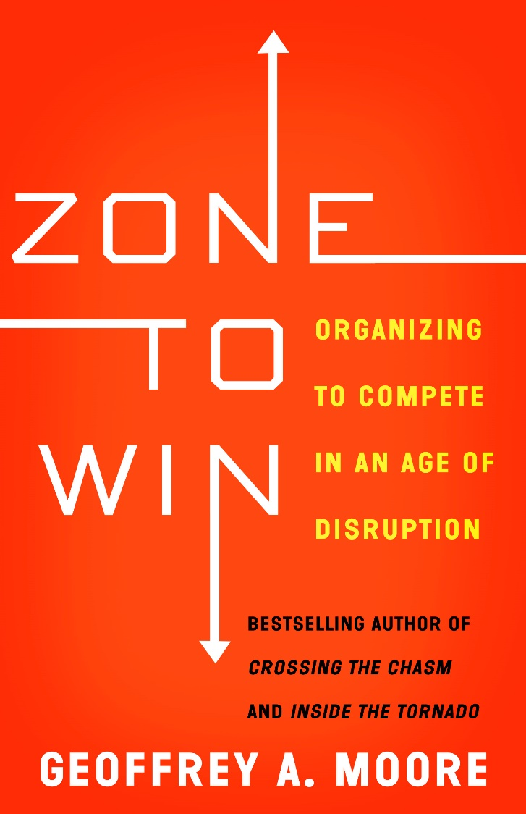
Adapting Zone To Win For Business Value Value Creation
Transformation
Zone
Performance
Zone
Make a
big change
Make the
top line
Incubation
Zone
Productivity
Zone
Create options
for the future
Make the
bottom line

Slide 3
Starting the Business Value Creation Dialogue
How does our company create value today?
What could dilute or disrupt that value?
How can we use digital technology to drive new value creation?
How open is our culture to changing the way we do business?

Slide 4
Three Sources of Business Value Creation
Systems of Record – The Backbone for Transaction Management: The center point for an SOR is a database that supports a core asset of the company such as CRM system, Supply Chain Management system, HR system. It must be accurate, up to date and secure. As such, from a corporate governance point of view, both ingress and egress must be tightly controlled by the company.
Systems of Engagement – The Platform for User Experience: The center point for an SOE is a moment of engagement with a target customer of the company where the goal is to enable and enhance the customer experience. Such systems must be friction free, immediately accessible and emotionally as well as intellectually dimensional. Ingress and egress are basically unrestricted and controlled by the end user.
Systems of Intelligence – The Lifeline for Future Innovation: The center point for an SOI is a synthesis of log files being processed by an analytical application to detect triggers for taking action. Be that to make a personalized offer to a consumer online, conduct preventative maintenance on a machine, or targeting a digital ad at the person most likely to respond to it. Such systems must operate at exceptional speed and scale, typically hosted in a cloud-based computing farms and utilizing Big Data stores.

Slide 5
4 Zones Model: Business Value Creation Portfolio
Disruptive
Innovations
Sustaining Innovations
Transformation
Zone
Performance
Zone
Mission Critical
Scale material net new lines of business
Utilize digital technologies to enter adjacent markets
Develop & deploy systems of engagement to increase customer experience value
Utilize systems of intelligence to better understand and deliver new customer value
Incubation
Zone
Productivity
Zone
Enabling
Utilize Agile, Lean & DevOps to increase time to value
Identify, test & validate next generation products, services and new business ideas
Recover trapped value by consolidating, replacing or eliminating systems of record
Optimize SOR maintenance costs and reduce technical debt

Slide 6
Performance Zone
The Performance Zone is charged with serving the company’s customers and creating near-term financial returns. It represents the revenue generation arm of your business today. It provides the operating income to fund both your current and future operations.
Develop and deploy systems of engagement
Develop and deploy systems of intelligence

Slide 7


Use Cases

Slide 8
Productivity Zone
The Productivity Zone is charged with making the performance zone more efficient and more effective as well as insuring the company complies with all regulations. It consists of all the cost-center functions that provide these services.
Optimize the costs of maintaining the company’s Systems of Record
Simplify complex, redundant and siloed systems & processes

Slide 9

The Trapped Value Recovery Exercise Some core questions to ask
Where is the trapped value in our company today?
How can we identify and unlock this trapped value?
Eliminate or consolidate Systems of Record
Simplify Systems of Record
Replace Systems of Record
How can we redeploy this trapped value against critical new business value investment priorities?
Note: This is not a cost reduction exercise it’s a resource & budget redeployment exercise

Slide 10


Use Cases

Slide 11
Incubation Zone
The Incubation Zone is charged with exploring new products, services and businesses that can leverage new digital technologies and potentially have an significant impact on future business growth opportunities.
It also serves as the staging area for all major projects and includes project prioritization, demand management and resource allocation governance processes.

Slide 12
Incubation Zone: Increase Time To Value Building a new PMO process
Disruptive
Innovation
Sustaining
Innovation
TRANSFORMATION
ZONE
PERFORMANCE ZONE
Material
Revenues
BUS MODEL
OPER MODEL
PRODUCTIVITY
ZONE
Enabling
Investments
Staging Area
INFRA MODEL
INCUBATION
ZONE

Slide 13
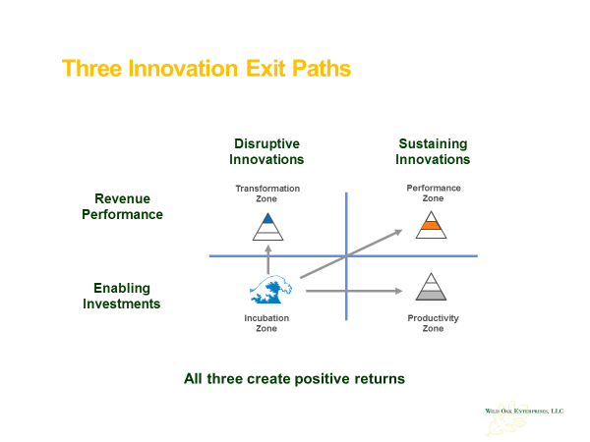
Project Prioritization Some core questions
Are they sustaining innovations or disruptive innovations?
Are they enabling systems productivity and cost optimization?
Are they increasing business unit performance and revenue growth?
Are they enabling business model transformation?

Slide 14
Demand Management Some core questions
Should we do it? Does it align with and support critical business outcomes?
Can we do it? Do we have the relevant skills, capabilities and capacity to achieve the outcome?
Did we do it? Do we have the right metrics to measure the achieved outcome vs. the desired outcome?

Slide 15
Transformation Zone
The Transformation Zone is charged with driving an enterprise-wide change at scale, creating a net new source of earnings. The two primary sources of net new earning are:
Scaling a new business to 10% or greater of current company overall revenues
Leveraging digital technology to enter adjacent markets

Slide 16


Use Cases

Slide 17
4 Zones Model: Business Value Creation Metrics Specific metrics for each zone
Transformation Zone
Performance Zone
Revenue hypergrowth
Win/loss ratio
Churn
Customer acquisition cost
Partner engagement
Bookings vs. plan
Revenue vs. plan
Contribution margins
Market share
Wallet share
Hypergrowth
Metrics
Investor
Metrics
Incubation Zone
Productivity Zone
10X performance advantage
Time to Value
Adoption & Utilization
User engagement
Category positioning
Cost optimization
Regulatory compliance
Technical debt reduction
Undesired attrition
Net Promoter Score
Venture
Metrics
Process
Metrics
Key Takeaway
Don’t use the metrics of one zone to measure the performance of another zone

Slide 18
Contact Information
Peter D. Moore
President
Wild Oak Enterprises LLC
310-395-2476
pdmoore@woellc.com

